Slide 1
w207: Predicting Movie Performance
Ryan Brown, Trevor Dalton, Dimitrios Psaltos, Noah Prozan

Slide 2
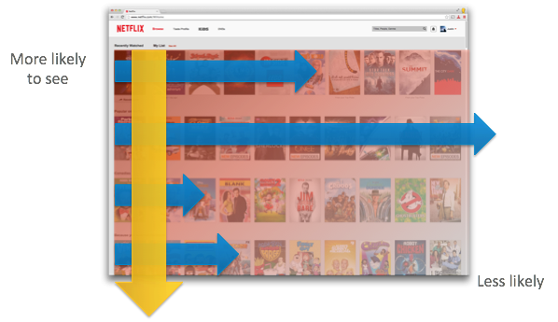
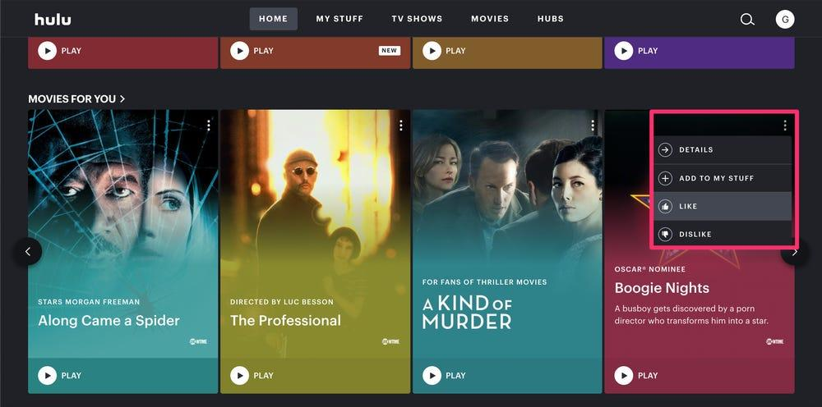
Motivation
Machine Learning is being increasingly used in the movie industry
Streaming platforms (ie. Netflix, HBO), attempt to maximize customer retention using targeted recommendations (SVD & RBM models)
20th Century Fox, predicted movie audience using movie trailers (neural network)
Companies across industry are interested in data driven insights
Notes:
Motivation- Introduce your question and why the question is interesting. Explain what has been done before in this space. Describe your overall plan to approach your question. Provide a summary of your results. (15%)
https://medium.com/ds3ucsd/data-science-in-the-film-industry-part-2-movie-trailers-and-artificial-intelligence-64b3cbd267c1
(High level - how ML has been used for movie industry)

Slide 3
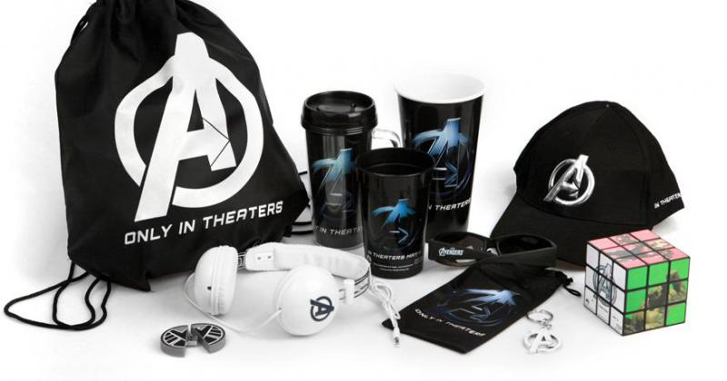
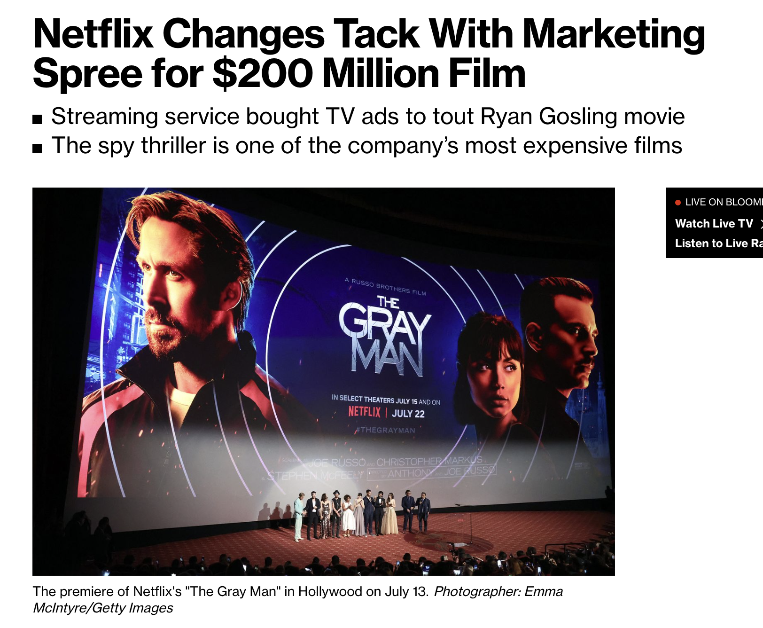
Our Task
Movie merchandising: Products/commodities based on a movie which are used to promote a film and act as a revenue stream.
Star Wars - $40B in merchandising revenue
Harry Potter - $25B in merchandising revenue
Question: Using publicly available data, can we predict whether a movie will be well liked, prior to its release?
Value Proposition: If a movie is expected to be well liked, studios can start marketing campaigns earlier and expand revenue opportunity
Our Reasoning:
Critics are 1st to see and rate a movie - we care about their opinions
Analyze movie data to identify features indicative of ratings
Build a ML model to predict a movie’s rating based on these features
Notes:
https://www.ciiblog.in/movie-merchandising-is-a-potential-hit/ - article of movie merchandising
https://www.openpr.com/news/1631327/movie-merchandise-market-analysis-strategic-assessment-and-trend-outlook-by-sony-pictures-paramount-pictures-warner-bros-huayi-brothers-enlight-media-lionsgate-films-nbc-universal-nickelodeon-toei-company-alpha-group-the-walt-disney-company-a.html - merchanside image

Slide 4
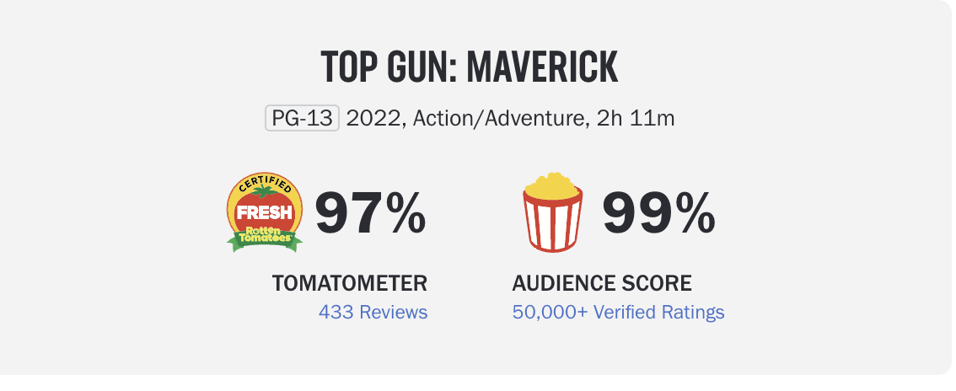
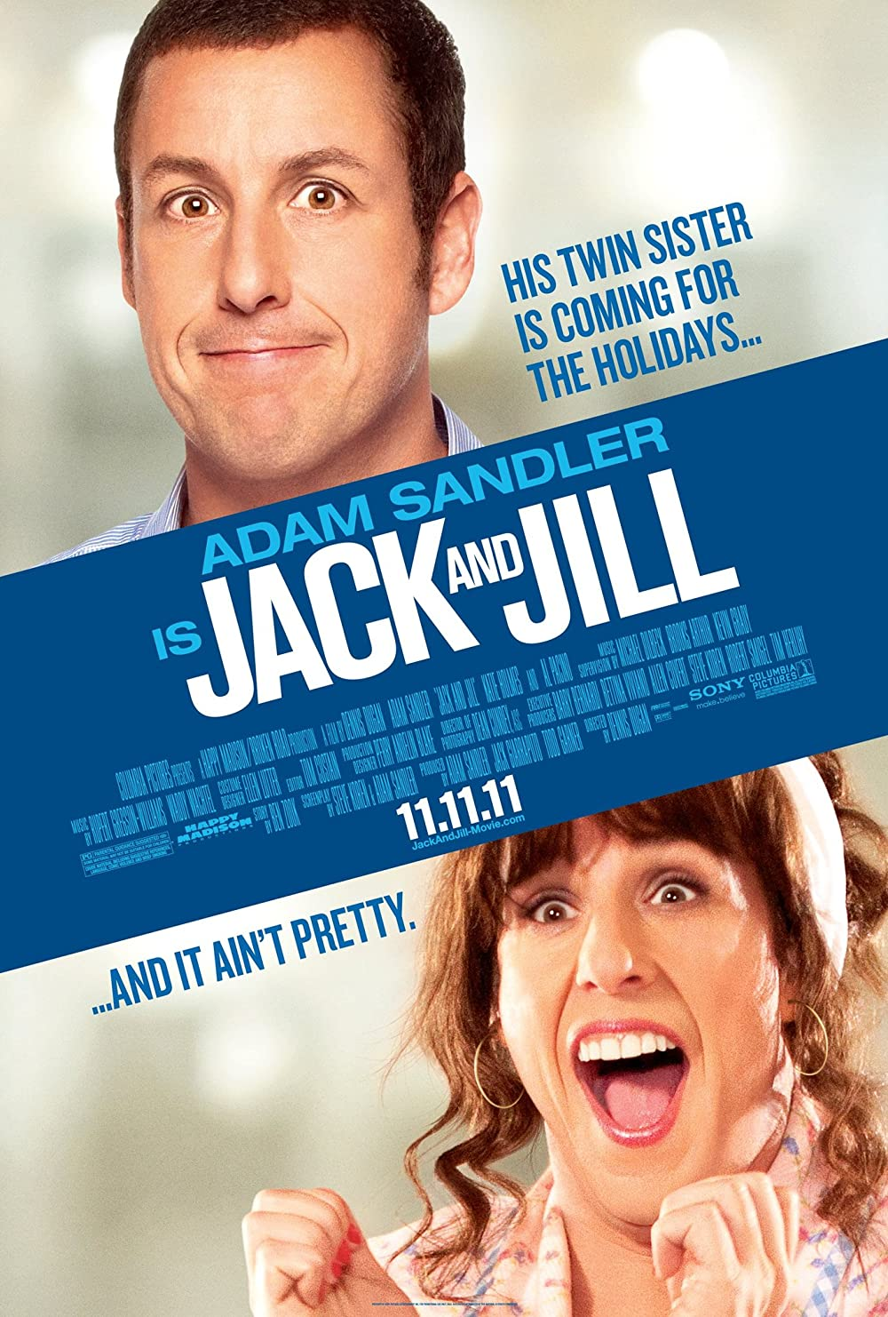
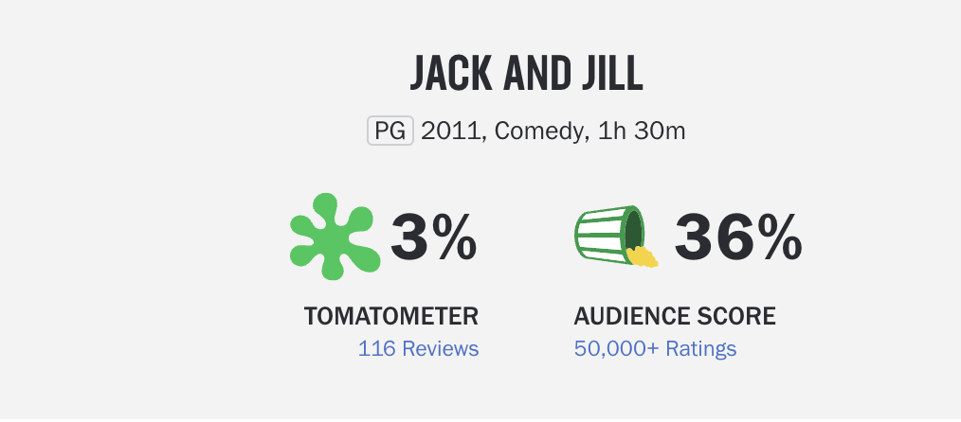
Data - Rotten Tomatoes Movies Data Set
Rotten Tomatoes: One of the largest movie rating sites
History: Dataset scraped from Rotten Tomatoes website (up to 2020-10-31) and available on Kaggle
2 Datasets (movies and critics) - using movies
Movies Dataset: Movie level info (movie title, release date, description, genre, directors, actors, etc…)
Size = 17712 x 23
Data Includes:
Movie Fixed Effects: runtime, content rating, release month (movie and streaming), production company, title, directors, actors, genres (ie. action & adventure, comedy, drama, romance (21 total))
Reviews: critics consensus - summary of multiple reviews
Target: Tomatometer Rating - Unique Rotten Tomato movie rating (Fresh or Rotten)
Link: https://www.kaggle.com/datasets/stefanoleone992/rotten-tomatoes-movies-and-critic-reviews-dataset
Notes:
https://filmlifestyle.com/best-sites-for-rating-movies/ - for rotten tomatoes being popular
Why did we focus on tomatometer status? - 1. Critic reviews are released before opening weekend and can dictate viewership during the most important money making period
2. Lots of variability in audience ratings, but had a minimum number of critic ratings

Slide 5
EDA and Feature Generation
Derived Movie Features:
Production Company sum (frequency)
Genres sum (frequency)
Delta Runtime (difference from average)
Title length (n characters)
Release date (month #) - movie and streaming release
Content Rating (label encoder)
Critic Consensus length (n characters)
Director count and sum (frequency*)
Actor count and sum (frequency*)
Genres (one hot encoding)
Critic Consensus (Text Embedding**)
* Actors and Directors in <2 movies were treated as 0s for sum feature, ** For BERT and LSTM models
Data Cleaning:
Tomatometer Status (Fresh - 1/Rotten - 0)
Only use movies after Rotten Tomatoes creation (1998)
Rows with missing values were removed
Final Featureset:
33 features
N = 6510 - (1 =54% | 0 =46%)

Slide 6
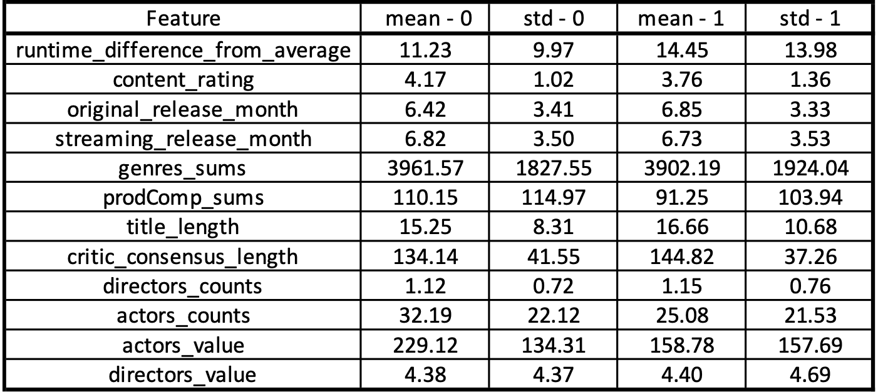
EDA and Feature Generation
Data Cleaning:
Tomatometer Status (Fresh - 1/Rotten - 0)
Only use movies after Rotten Tomatoes creation (1998)
Rows with missing values were removed
Final Featureset:
6510 movies x 33 features
(1 =54% | 0 =46%)
Derived Movie Features:
Production Company sum (frequency)
Delta Runtime (difference from average)
Title length (n characters)
Release date (month #) - movie and streaming release
Content Rating (label encoder)
Critic Consensus length (n characters)
Director count and sum (frequency*)
Actor count and sum (frequency*)
Genres (one hot encoding)
Critic Consensus (Text Embedding**)
* Actors and Directors in <2 movies were treated as 0s for sum feature, ** For BERT and LSTM models
Notes:
In order to establish our final featureset, we needed to apply some data cleaning. First, we binarized our output variable (Fresh was True (1) and Rotten was False (0). Next we excluded any data after 1998, which was the year Rotten Tomatoes was founded - our thinking was that movies could only be rated effectively if done as soon as movie is being released, and avoiding any historical bias. Lastly, any rows with missing values were removed. This resulted in a final feature set of about 6500 movies with 33 features. We did need to do some Feature Generation: as shown in the list on the left.
From our EDA, we did see some group differences in features like Release Month, Production Company, and actors.

Slide 7
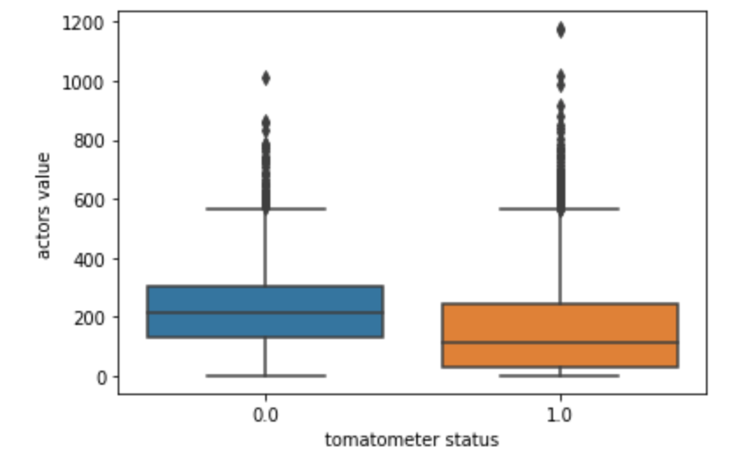
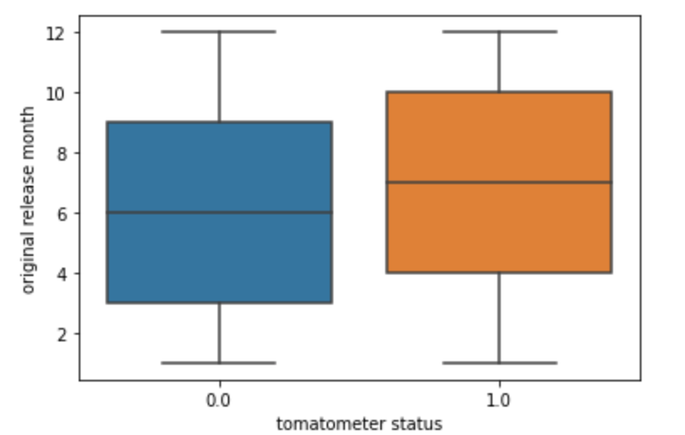
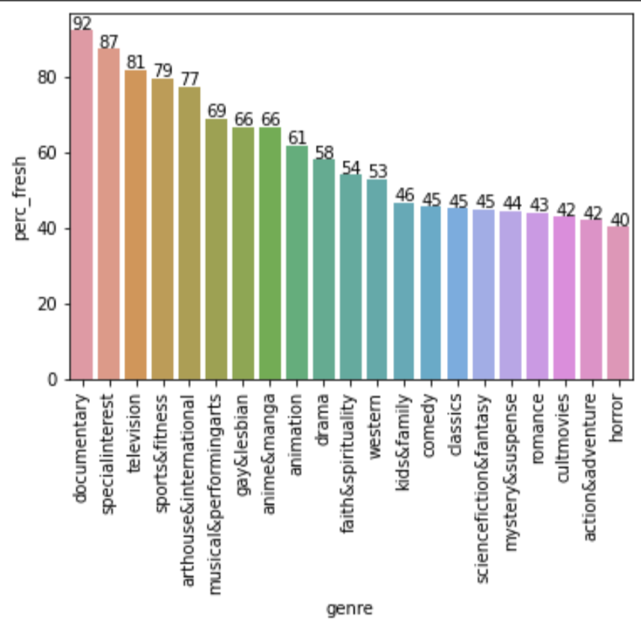
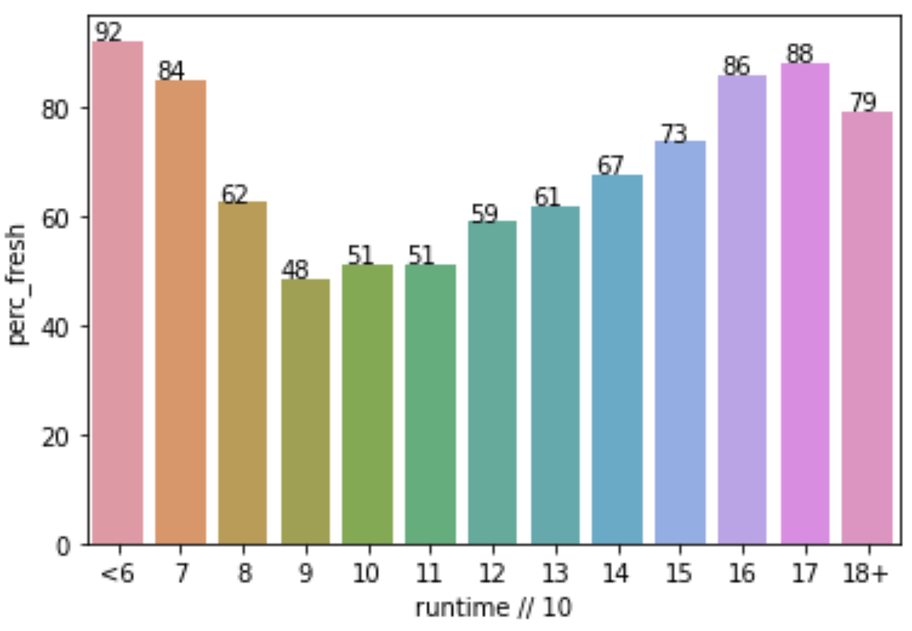
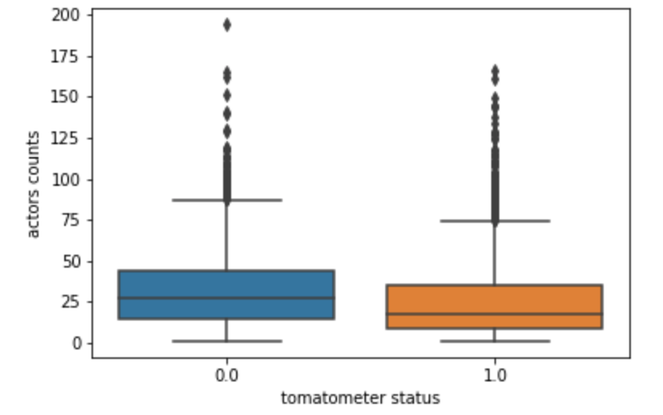
EDA/Relevant Statistics
Notes:
Wanted to also share a few visuals which underscore the differences we see between label groups in individual features.

Slide 8
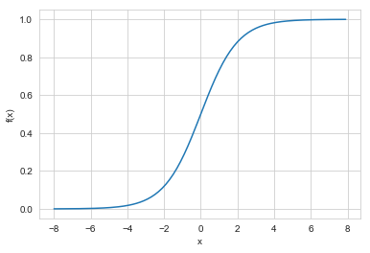
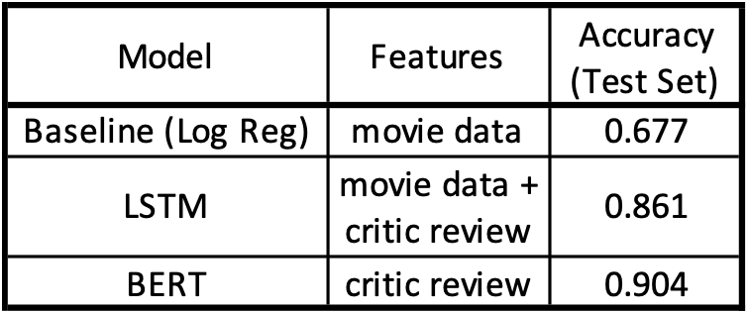
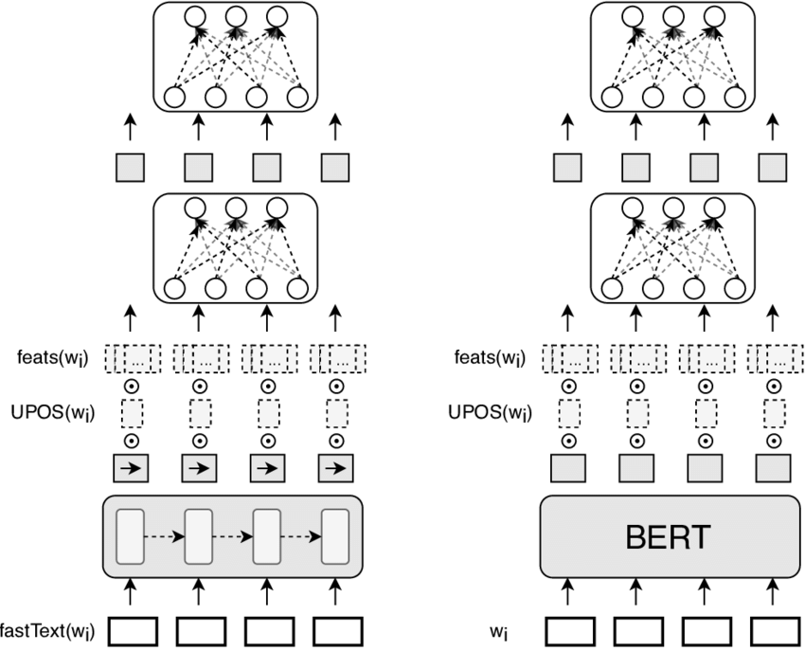
Approach
Data preprocessing
Train, val, test split: [60, 20, 20]
SKLearn - Standard Scaler
Test embedding for critic consensus
Rational behind approach:
Can just movie fixed effects be used?
Can just a single review be used?
Do we need a combination?
Models used:
Baseline: Logistic Regression (Widely used for binary classification)
LSTM (Allows for multiple feature types - review text + movie features)
BERT (Currently best for text analysis)
Metrics:
AUC, Accuracy
Notes:
Our Approach was as follows: 1. We split the data 60, 20, 20 0 train test val, and applied a standard scalar to the fixed effect features. We also applied text embedding for the critic consensus features
We leveraged several different features in order to see what distinct features would have a great impact on our model. We are looking at whether fixed effects, only a single review (critics consensus) or a combination of these features would be required for our model.
WE Used 3 different types of models: Baseline - Log Reg, LSTM, and Bert. Bert performed the best, as we will go into later, and the results are displayed on the top right of my screen.
Our Outcome metrics were AUC and Accuracy.

Slide 9
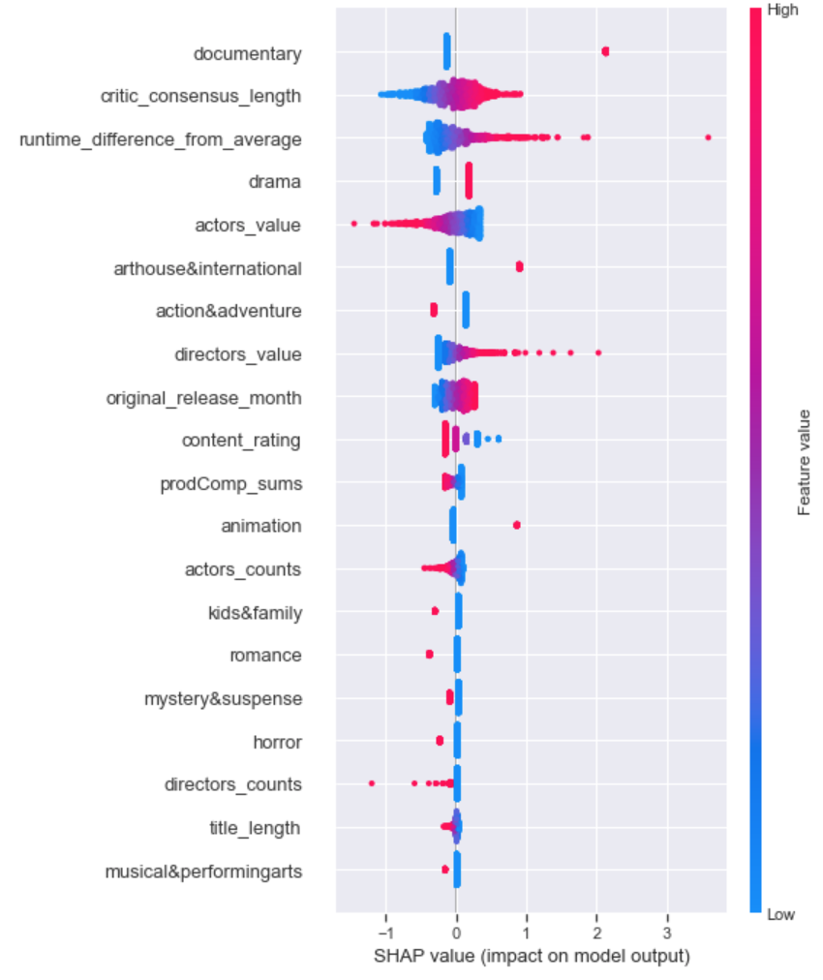
Baseline Model - Logistic Regression
Features: Movie Fixed Effects - (33 features)
Implementation: SKlearn Linear Model - Logistic Regression
Hyperparameters: (C - regularization strength, Penalty)
Tuned to validation dataset (predefined split)
Best Hyperparameters: (C=0.234, penalty='l1', solver='liblinear')
Notes:
L1, L2
Our Baseline model was a Logistic regression model, implemented as a closed form solution using SKLearn. On just the fixed effect movie features, the untuned model achieved about 68.8% accuracy on validation set. Next, we tuned the hyperparameters for the model using a GridSearch approach. The hyperparameters tuned were C (regularization strength and the penalty). The best hyper parameters are displayed on the screen. This tuned model had a 0.01% increase on the model performance. Lastly, we applied this tuned model, trained on validation + train data, to the set set. There was a slight decrease in accuracy, as expected when using unseen data - but the model seems to generalize well to an usceen dataset. The final accuracy score was about 67.7% and was used as the benchmark for our other models.

Slide 10
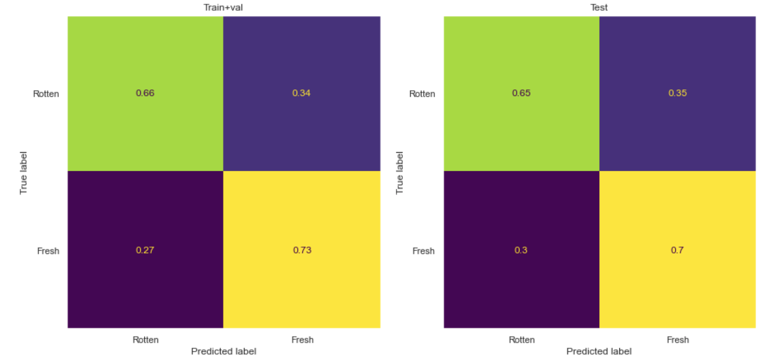
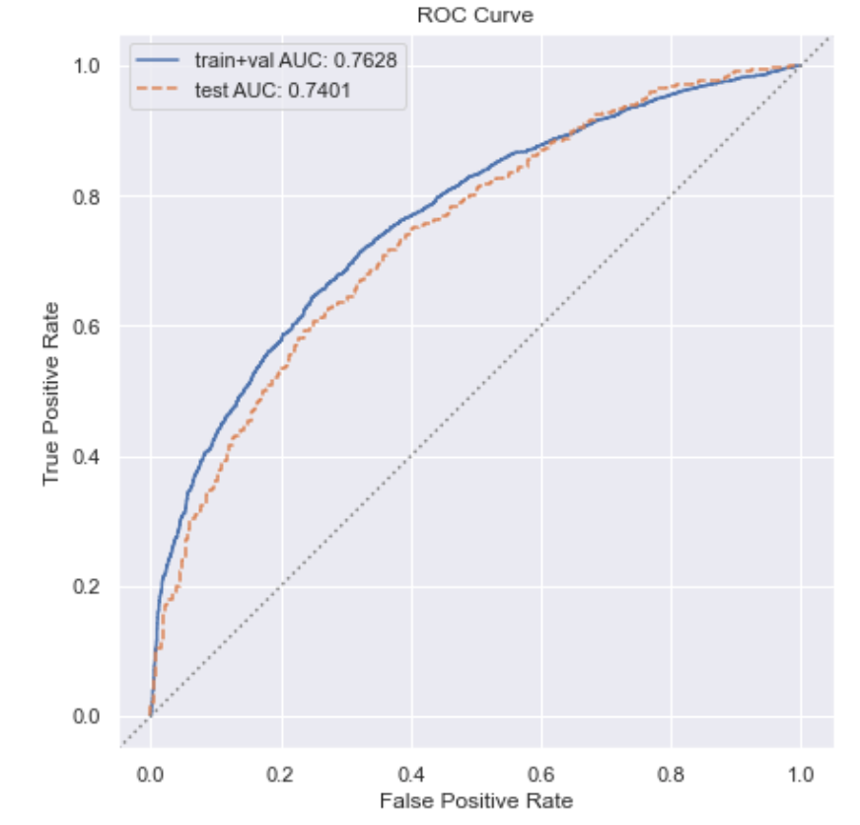
Logistic Regression Results
Notes:
Displayed are the results of the Logistic Regression model. You can see that the Confusion matrix shows reasonable performance between train + val and test sets, perhaps resulting in a few false positives. We were able to achieve a ROC score of 0.74 on the test set.

Slide 11
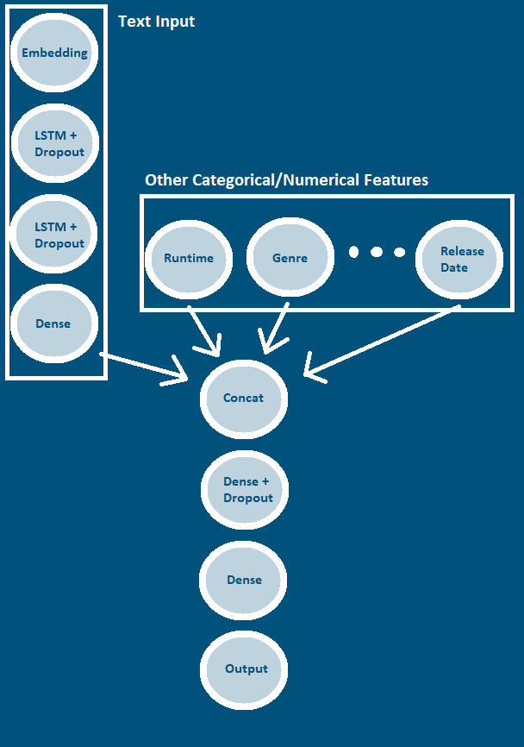
LSTM w/ spaCy word
embeddings
Data: Movie features + Critics Consensus - (34 features)
Critics Consensus found to be far more valuable than the fixed features
Implementation: LSTM
Hyperparameters: (LSTM units, dense units, dropout rate, etc.)
Best hyperparameters found through the Keras Tuner HyperBand algorithm
Notes:
We decided to build on what we had done

Slide 12
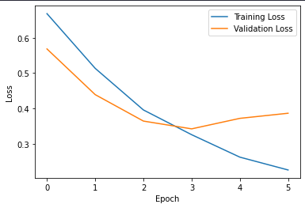
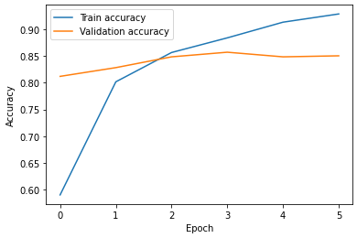
LSTM w/ spaCy embeddings Graphs
Notes:
Final Accuracy:
Train: 0.9047
Validation: 0.8685
Test: 0.8610

Slide 13
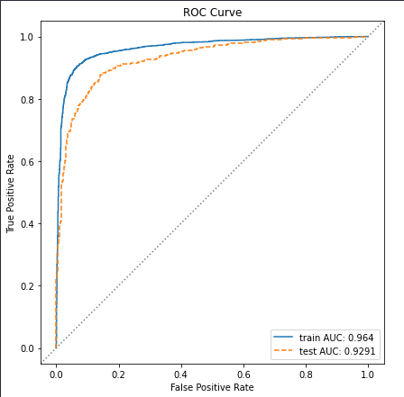
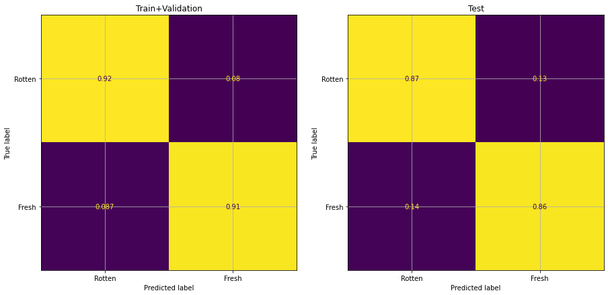
LSTM w/ spaCy embeddings Graphs
Notes:
We have a fairly balanced positive and negative labels

Slide 14
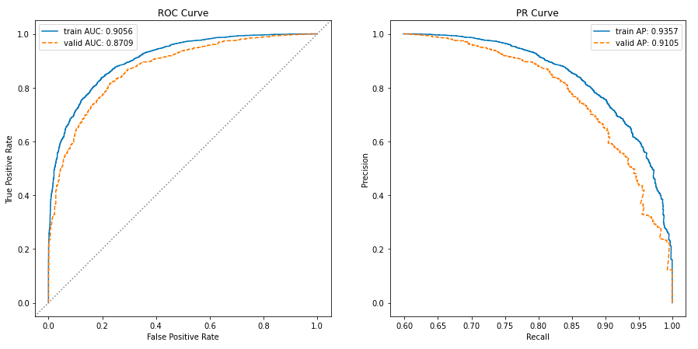
Revisiting critics consensus: Logistic + Ridge Regularization baseline on token counts

Slide 15
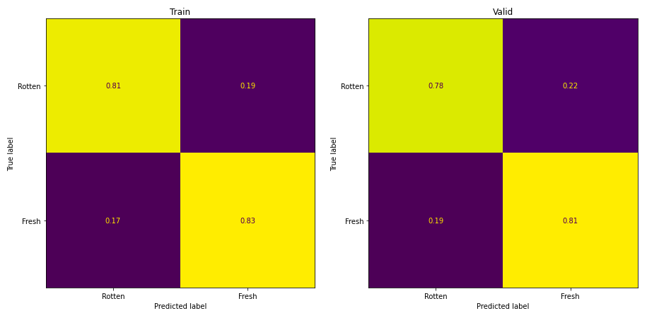
Logistic baseline continued

Slide 16
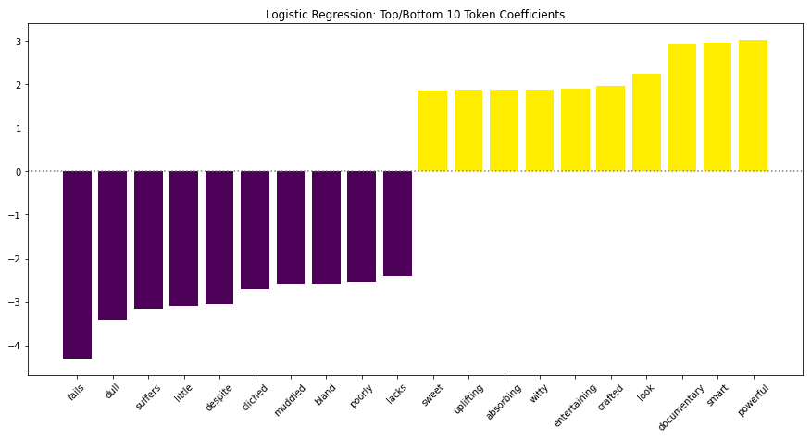
Model Explainability: Logistic Baseline

Slide 17
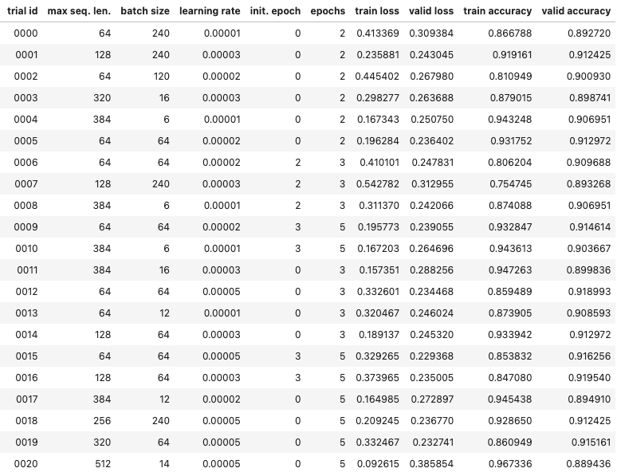
BERT on Critics Consensus: Hypertuning
Trials 14/16 selected:
{'learning_rate': 3e-05,
'max_length': 128,
'batch_size': 64}

Slide 18
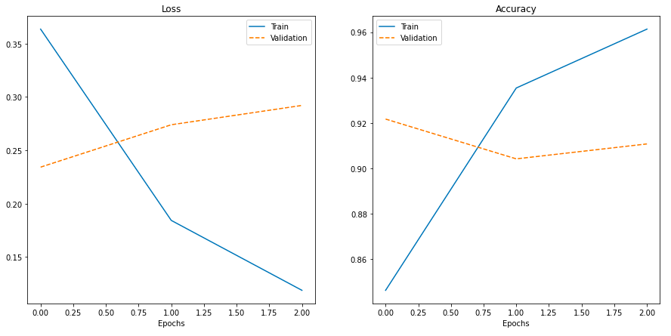
Retrain on hyperparameters over 5 epochs
Best perf. After single epoch
Early stop at epoch 3

Slide 19
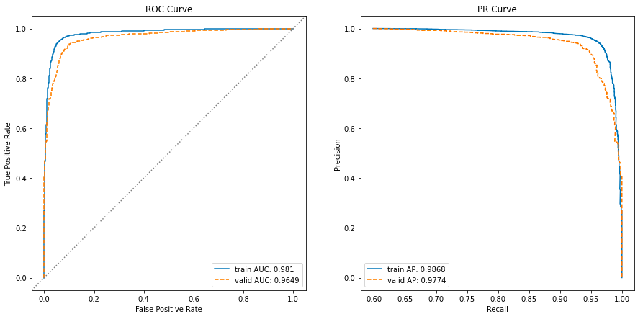
Hypertuned BERT AUC

Slide 20
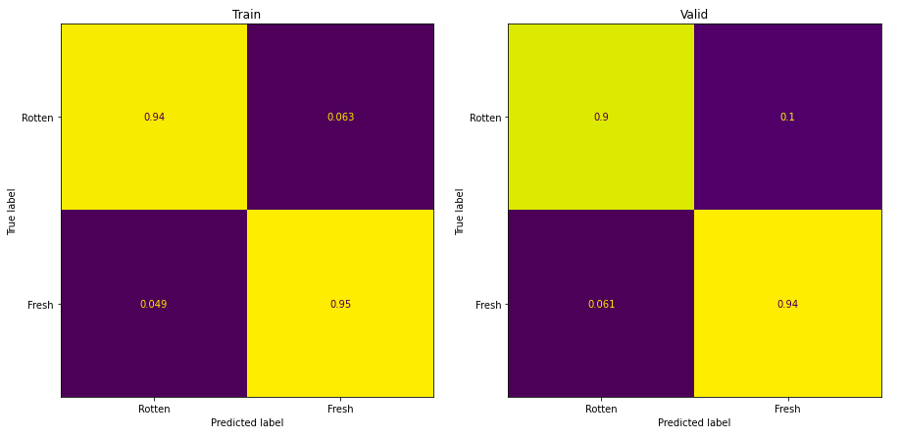
Hypertuned BERT Continued

Slide 21
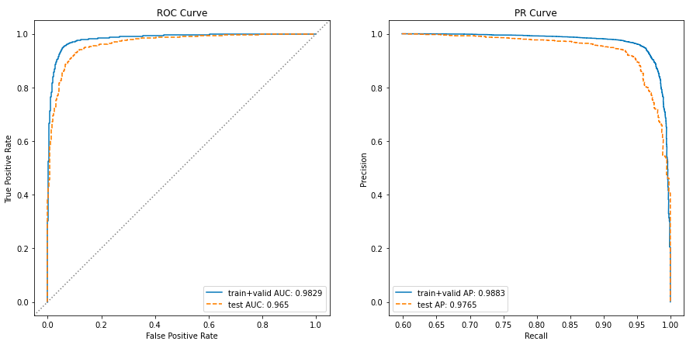
Retrain over One Epoch on Train + Valid

Slide 22
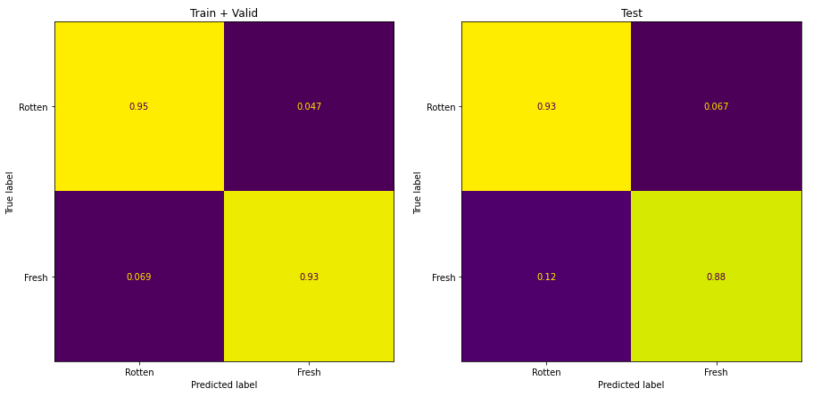
Final BERT Performance Continued

Slide 23
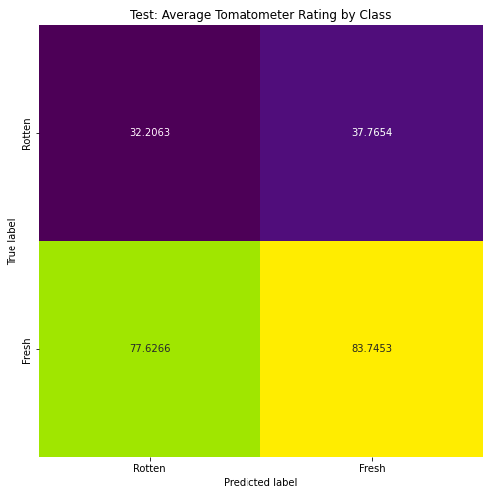
Exploring Association with Continuous Response
Clear association with higher/lower ratings for incorrect classifications

Slide 24
Comparing Performance

Slide 25
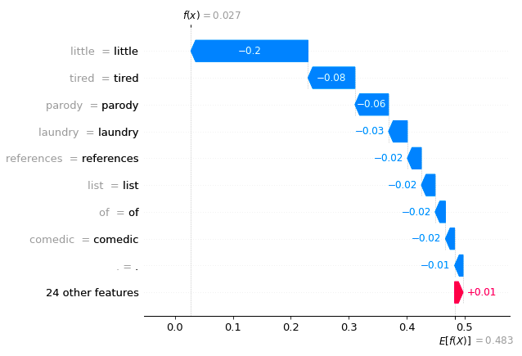
Model Explainability: Final BERT SHAP
“Loaded Weapon 1 hits all the routine targets with soft squibs, yielding a tired parody that cycles through its laundry list of references with little comedic verve.”

Slide 26
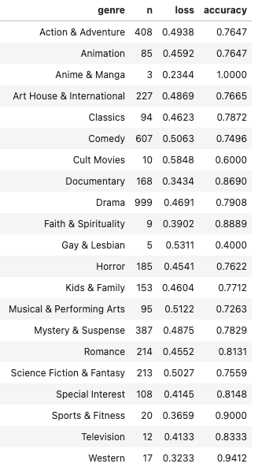
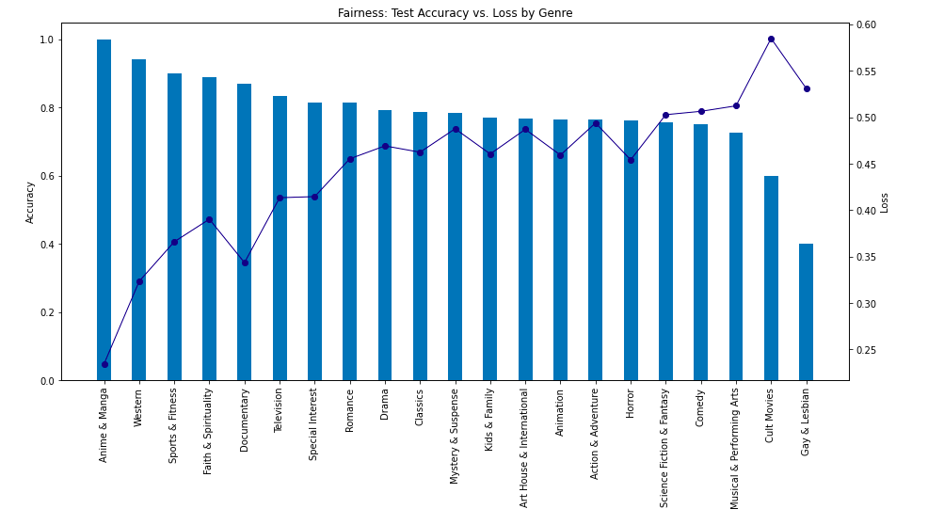
Fairness
Notes:
Ryans plot will be used - Create table with count of genres @Ryan

Slide 27
Conclusions
Key Results:
Using publicly available data, we can predict whether a movie will be well liked, prior to its release with roughly 90% accuracy
DistilBERT is a powerful model and just using one review can predict how accurate a movie is with a 90% accuracy
Review Level data is more accurate than fixed effect data
Feature engineering improved models slightly
Our models suffered from a fairness problem, particularly in genres
Moving forward:
How can we collect a corpus of reviews to make movie level predictions more accurate?
How do we communicate to key stakeholders about our movie prediction?
Notes:
Model performances:

Slide 28
Contributions/Primary Areas of Focus
 | Ryan | Dimitri | Trevor | Noah
Theoretical/Market Research | X | X | X | X
EDA | X | X | X | X
Data Cleaning | X | X | X | X
Feature Engineering | X | X | X | X
Model Making | DistilBert | LogReg | LTSM | Model Review
Presentation Slides | X | X | X | X

Slide 29
Link to Code Repo
https://github.com/trevorjd3141/w207-movie-project

Slide 30
References
https://www.rottentomatoes.com/
https://www.kaggle.com/datasets/stefanoleone992/rotten-tomatoes-movies-and-critic-reviews-dataset
https://en.wikipedia.org/wiki/Scikit-learn
https://towardsdatascience.com/logistic-regression-ca2d070a3eee
https://www.bloomberg.com/news/articles/2022-07-15/netflix-changes-tack-with-marketing-spree-for-200-million-film
https://cloud.google.com/blog/products/ai-machine-learning/how-20th-century-fox-uses-ml-to-predict-a-movie-audience
https://medium.com/ds3ucsd/data-science-in-the-film-industry-part-2-movie-trailers-and-artificial-intelligence-64b3cbd267c1
https://www.researchgate.net/figure/The-baseline-LSTM-based-left-and-BERT-based-right-models-for-the-NER-task-along-with_fig1_346373540
https://towardsdatascience.com/logistic-regression-detailed-overview-46c4da4303bc
https://filmlifestyle.com/best-sites-for-rating-movies/
https://www.ciiblog.in/movie-merchandising-is-a-potential-hit/
https://www.openpr.com/news/1631327/movie-merchandise-market-analysis-strategic-assessment-and-trend-outlook-by-sony-pictures-paramount-pictures-warner-bros-huayi-brothers-enlight-media-lionsgate-films-nbc-universal-nickelodeon-toei-company-alpha-group-the-walt-disney-company-a.html

